Slide 1
Introducing the Internet to the over-60s: Developing an email system for older novice users
A.Dickinson, A.F. Newell, M.J. Smith, R.L. Hill
Interacting with Computers 17 (2005)
pp. 621 - 642

Slide 2
Contents
Abstract
Introduction
Background
Email: Previous Research
Design
Development
Final Prototype
Radically Simple Design

Slide 3
Contents
Evaluations
Participants
System Setup and Apparatus
Visit Structures
Tasks
Protocol
Measures
Results and Discussion
Autonomous Usability
Error Rates
User Hesitations
Requests for Help and Facilitator Inverventions
Ratings
Qualitative and Subjective Reponses

Slide 4
Contents
Methodology Notes
Think Aloud
Divided Attention
Comparison System
Interface Tensions
Conclusion
References

Slide 5
Abstract
Contemporary technology offers many benefits to older people, but these are often rendered inaccessible through poor software design.
Developing usable software that would help to introduce older people to the Internet.
The project is intended to show that it is possible to design usable technology for this group and to explore some of the issues involved in doing so.
The system produced demostrated the success of design decisions: it was significantly easier to use than, and preferred to a commercial equivalent by a group of older people with no experience of Internet use.

Slide 6
Keywords
Design
Older people
Internet
Email
Digital inclusion
Usability

Slide 7
Introduction
Standard computer technology is inappropriate for a large, and growing, proportion of population: people over 60, who are, as a group, unlikely to use computers, less likely to know about computers, more likely to be anxious about using them and will find them harder to use than younger people do (Czaja, 1997; Hawthorn, 1998; Marquie et al., 2002).
Development and evaluation of an exemplar email system for the elderly is described.

Slide 8
Background
Older adults find standard interfaces harder to use than younger adult do even when computer experience is controlled for (Chadwick-Dias et al., 2003).
Older people are also significantly more likely to be inexperienced computer users (ONS, 2004).
Morris describes this divide as the ‘technological alienation’ of older people (Morris, 1992).
More encouraging experiences engender a more positive attitude to computers (Danowski and Sacks, 1980).

Slide 9
Background
The system was to be
‘’attractive to older users (over 60 years of age) who were uninitiated and unconfident in the use of computers and for whom the internet was an alien territory’’.

Slide 10
Email: Previous Research
Email, the internet application most used by older computer users (Coyne and Nielsen, 2002).
There are clear social reasons for email being attractive to older adults: networks of families and friends are increasingly widely spread (Grundy, 1996) and social isolation can be associated with ageing (Russell and Schofield, 1999).

Slide 11
Email: Previous Research
Hawthorn’s SeniorMail is a redevelopment of the Microsoft Outlook Express interface to support the older users.
SeniorMail alters the visual presentation of the system (bigger buttons, larger font size, etc) and has a list of possible actions presented in a simplified menu, and navigation (Hawthorn, 2002).
Influenced by Outlook Express.
The system is designed to offer functionality than relatively experienced users require and, as such, is unlikely to be optimally designed for beginners.

Slide 12
Email: Previous Research
Arnott and Khairulla developed a prototype email system with a group of older users of varying experience, basing their initial prototyping on existing email interfaces, and reached conclusion similar to those reached by Hawthorn (Arnott et al, 2004).
Central to both systems was reduced functionality and an initial menu system.

Slide 13
Email: Previous Research
Although the literature indicates a fundamental need for an appropriate email system that can be used autonomously by older users with little computer experience, there has been little recent work on how such a system might be developed.
Research in this field lacks a comparative evaluation of a specially designed system with a commercially available one.

Slide 14
Design
Inexperienced users are likely to encounter difficulty with terminology (Janicki, 2002; Crystal, 2001) and with a range of interface conventions, including: when to double-click with the mouse, how to move between text input fields and how to use the scrollbar (Ellis and Kurniawan, 2000; Coyne and Nielsen, 2002).
Based on difficulties and on research which demostrates that older adults are likely to encounter barriers to internet use in terms of vision (Carmichael, 1999; Hawthorn, 2000), cognition (Czaja and Lee, 2003), and manual dexterity (Ranganathan et al., 2001), a number of guidelines were agreed at the beginning of the project.

Slide 15
Design
Level of functionality:
Only essential functionality for a working email system to be included.
Each screen to have a very clear primary function.
The number of actions / buttons per screen kept to a minimum (fewer than 10) (Miller, 1956).
Accessibility
Larger than average clickable target (32 and 26 pt size recommended).
Larger than average fonts (14 points as a minimum).
High contrast choice of colours for text and background.
Accessibility features compatible with the W3C guidelines.

Slide 16
Design
User interface paradigms
Simple and very consistent select and operate paradigms.
Clear conventions for the positions of button and information.
No new or poorly established interface paradigms which were unlikely to be understood by user group.
Avoid scroll bars if possible, and definitely do not use nested scroll bars.
Terminology
Terminology which was understandable by the user group.
Personalization
Some personalization to allow for people with poor eye sight or dexterity, for example the ability to easily increase text size.

Slide 17
Design
Research indicates that older adults are likely to find it harder to make sense of a display (Newell et al., 2003), and will spend longer searching through an array of information (Fisk et al., 2004).
This central principle caused a difficulty, however: with ageing, spatial memory declines and deep interface structures create significant barriers to use for older adults who appear to lose their place and forget the purpose of the task (Zaphiris et al., 2003).

Slide 18
Development
The early development process depended heavily on expert feedback.
Paper prototypes of the design were presented to a workshop of nine older people aged between 65 and 84 who had little or no experience of computer use.

Slide 19
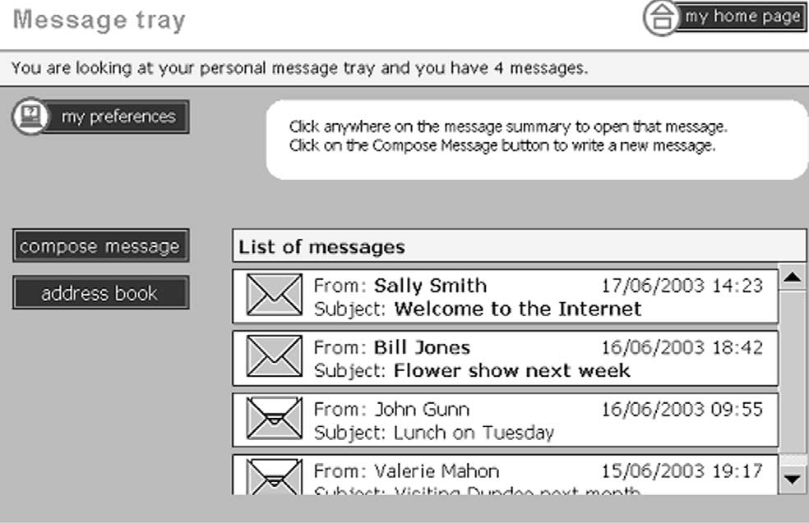
Development

Slide 20
Development
Button text was made bolder and clearer, and changed to dark text on a pale background.
The ‘my preferences’ button was moved from its intrusive position at the user’s ‘entry point’ to the screen. (Faraday, 2001).
Language was both simplified and clarified.
The two ‘orientation’ panels were combined into a single instructions panel with an eye-catching icon.
Terms like ‘my home page’ were removed because of uncertainty about who ‘my’ refer to.

Slide 21
Final Prototype
A final prototype email system was developed which comformed to as many of the initial design constraints as had been found to be technically feasible within the development period.
Functionality was conceived of as related to either reading or to sending a message.

Slide 22
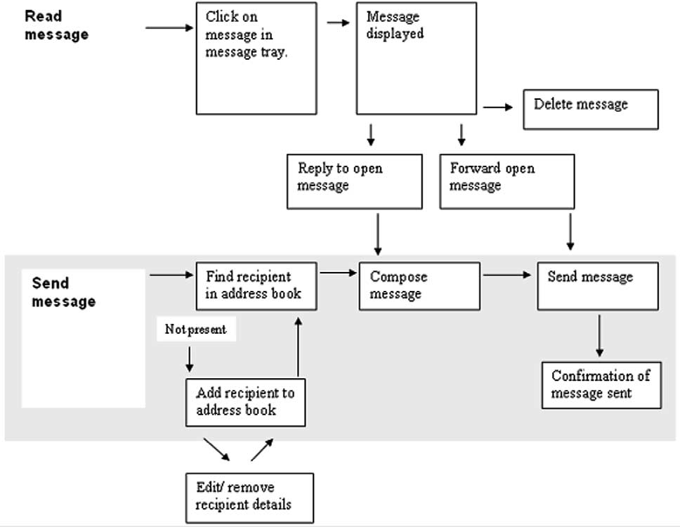
Final Prototype

Slide 23
Radically Simple Design
The design constraints had specified a simplication of the system, not only in terms of reduced functionality, but also in the presentation of information on each screen.
Single use pages allowed a single text input field per page, removing the difficulties associated with uncertainty about where text would appear.
The single purpose screens made it possible to have screen – specific help which supported the user as they were guided along a linear path to completing the task.
Simple, single purpose pages made it possible to have larger default text (14 points) and buttons (32 points), and also to allow personalization option which would further increase them in size.

Slide 24
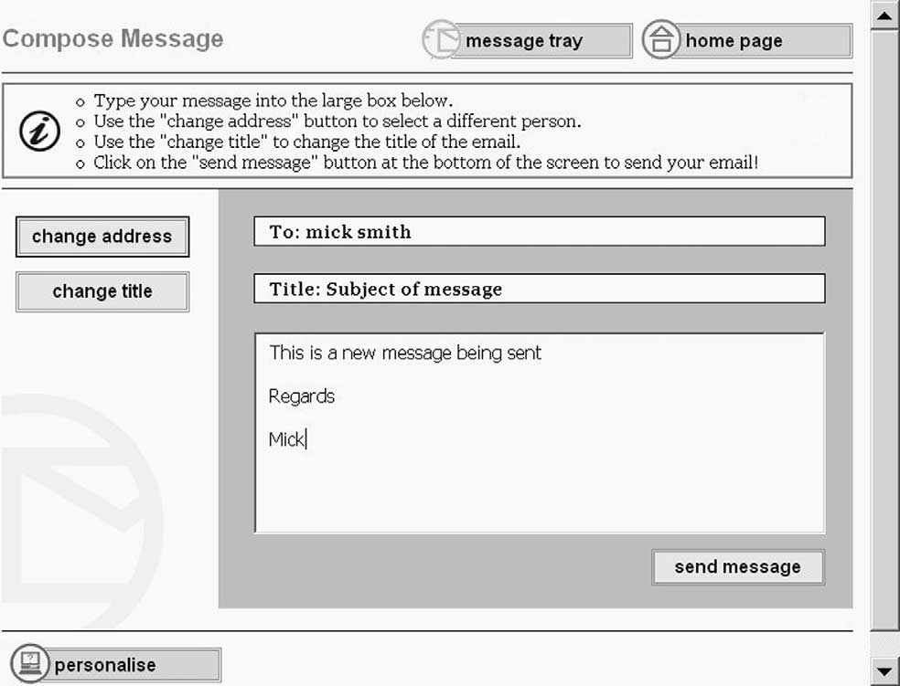
Radically Simple Design

Slide 25
Evaluation
The Cybrarian system was evaluated in a controlled environment over a 2-week period with 15 older people.
Outlook Express, a system commonly provided by Internet Service Providers, was chosen as the control system.
 | Female | Male | All
60-64 | 4 | 2 | 6
65-74 | 4 | 1 | 5
75-84 | 1 | 2 | 3
85+ | - | 1 | 1
All | 9 | 6 | 15

Slide 26
Participants
15 participants were selected with the minimal computer experience, lack of familarity with the Internet and a combination of minor age-related impairments.
All the participants had corrected vision, two had hearing aids, two had had strokes which left some minor motor control impairments and some concentrations and memory difficulties, and another two participants had minor fine motor control impairements.
Four people had other self-reported medical conditions.
Participants were paid 20 US dollars expenses per session.

Slide 27
System Setup and Apparatus
The apparatus used was a PC with 2.4 GHz processor, 512 MB memory, 40 Gb disk, CDROM, 15’’ LCD monitor, 10/100 Mbps UTP NIC running Windows XP Pro and the Internet Explorer 6 browser.
The system used was based on a POP3/SMTP server, which supported the email functionality.
Each user had an individual profile, which was available when they arrived for the first visit.

Slide 28
Tasks
Participants were asked to complete six tasks on each system in the first visit, and seven on each system in the second visit.
Each task was read from an A4 card by the facilitator and the cards was placed beside the monitor.
Tasks explored aspects of the interaction on levels of increasing complexity.

Slide 29
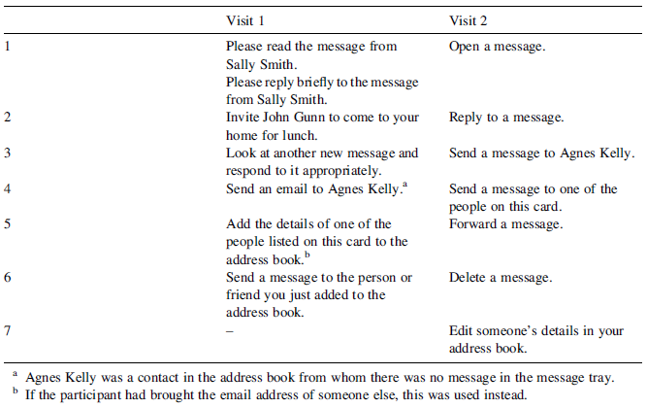
Tasks

Slide 30
Protocol
Facilitators worked according to a script and a set of instructions.
Notetakers also worked on instructions.
A training period and ‘dry run’ took place.
All notes were analyzed by the study co-ordinator to check consistency.

Slide 31
Measures
Was the user able to carry out tasks using the system?
The system tested by recording:
Tasks completed autonomously
The number and frequency of errors, hesitations, requests for help and facilitator interventions.
2. Which was the preferred system?
3. Was there evidence that users would continue to use the system?

Slide 32
Results and Discussions
Autonomous usability
Error rates
User hesitations
Requests for help and facilitator interventions
Ratings
Qualitative and subjective responses

Slide 33
Autonomous Usability
A 2 (System) X 2 (Visit) Analysis of Variance was conducted on the data to determine any difference in performance between using two systems.
A main effect of System [ F(1,11) = 9.366, p < 0.05] indicates that more participants successfully completed the range of different tasks using the Cybrarian software rather than the Control.
Performance did not alter significantly between visits [F(1, 11) = 0.162, p > 0.5] and lack of any interaction [ F(1,11) = 0.395, p > 0.5] between the two variables confirms that the benefit of using the Cybrarian software was not restricted to either the first and second visit in particular.
A Spearman’s correlation between task order and performance shows that increasing taks complexity did reduce the number of participants successfully completing the tasks using Outlook Express on both visits [rs(6) = -0.845, p < 0.05 and rs(7) = 0.879, p < 0.01, respectively].

Slide 34
Error Rates
The frequency of errors committed was another important component of participants’ experience in using the email system.
During Visit 1, 11 participants attempted Task 6 using the Cybrarian system, whereas only 7 out of the 15 participants were able to begin the identical task using the Control system.
In absolute terms, more errors were recorded on Cybrarian’s later tasks, partly because more people tried them.
Errors per user were significantly lower using the Cybrarian system [F(1, 11) = 17.423, p < 0.01]; indeed, the rate was often negligible under Cybrarian.

Slide 35
User Hesitation
Recorded hesitations are restricted to pausing directly related to a user’s general interaction with the interface.
A standardized measure of hesitations per user is included to the results.
The Cybrarian system was a simpler design and there was therefore less to look at on the screen, the significantly smaller number of hesitations per user that is produced [F(1,11) = 7.981, p < 0.05] is arguably unsurprising.
Using the control system led to higher levels of uncertainty, a greater lack of confidence, and greater confusion.

Slide 36
Request for Help and Facilitator Interventions
Participants were instructed not to request help unless they were genuinely stuck and unable to proceed.
The need for any form of help from the facilitator was significantly lower for the Cybrarian system [F(1, 11) = 27.103, p < 0.001].

Slide 37
Ratings
After each series of tasks was carried out with a system, participants were asked to rate the system they had just used for Ease of Use, Pleasantness and Ease of Remembering on a 7-point scale.
The ratings contrast between the two systems was analyzed using Wilcoxon Signed Rank Tests.
The results indicated a statistically significant preference for Cybrarian on all three measures across both visits.
The difference between the Cybrarian system, specifically designed for this group, and the control system was thus both reliable and pronounced.

Slide 38
Qualitative and Subjective Responses
At the end of each visit a short semi-structured interview took place to explore user reactions to the system.
Responses again indicated a strong preference for Cybrarian.
Participants indicated that they are going to use the new email application.
Participants also reported that they felt more inclined to explore other things that computers could do after they had used Cybrarian.
This response confirms Morris’ prediction that a positive initial experience with software encourages users to continue using computers (Morris, 1992).

Slide 39
Methodology Notes
Thinking aloud
Divided attention
Comparison systems

Slide 40
Thinking Aloud
Thinking aloud was a methodology that had been successfully used by the industry usability engineers on the project.
The use of the think aloud protocol with older users can generate rich and interesting information, but will increase the cognitive complexity of the task.

Slide 41
Dividing Attention
Interface complexity also appeared to have an impact on some users’ ability to use the keyboard and interface elements.
Participant 8 repeatedly forgot small details about using the computer and the keyboard when she was using the control system.
Such small errors, apparently unrelated to the system comparison, were not consistently recorded but observations like these suggest that a more holistic approach to the user experience might yield interesting supporting information.

Slide 42
Comparison System
Working with this user group has well-documented difficulties (Eisma et al., 2004).
One fundamental barrier to successful communication is the participants’ lack of knowledge about the area, which makes it very difficult to carry out traditional user-centred design activities or get useful subjective feedback from the users.
Using two different systems allowed users to compare and vitally, using Cybrarian successfully gave them the confidence to criticize Outlook Express.

Slide 43
Conclusion
Cybrarian which is a specially designed system was significantly more usable than an industry – standard equivalent.
The positive experience with the Cybrarian system led participants to be more confident about computer use generally, and about Internet use.
Cybrarian system differed from the commercial system in many ways; including a simplified interface, reduced clutter on the screen, reduction of terminology, clear and simple navigation paths, and a particular type of ‘help’.

Slide 44
Conclusion
Many of characteristics of the current Cybrarian system are also appropriate for other non-users.
Both research and experience indicate that initial impressions are very important in deciding whether or not people persevere with computers.
Once learners have developed confidence, they are capable of further exploration.

Slide 45
Conclusion
There is no doubt that contemporary computers are powerful enough to hide most of their excessive complexity from the user, but it is equally true that this involves a paradigm shift in managers’, designers’ and developers’ understanding of what a good computer system is, and a recognition that a market exists for appropriately design, simple interface.

Slide 46
References
Age Concern, 2002. IT, Internet and older people: management survey, Age Concern 2002.
Andrews, G.J., Gavin, N., Begley, S., Brodie, D., 2003. Assisting friendships, combating loneliness: users’ views on a ‘befriending’ scheme. Ageing and Society 23, 349–362.
Arnott, J.L., Khairulla, Z., Dickinson, A., Syme, A, Alm, N., Eisma, R., Gregor, P., 2004. Email Interfaces for Older People. Proceedings of the IEEE SMC International Conference on Systems,Man and Cybernetics, The Hague, The Netherlands, October 10–13.
Carmichael, A., 1999. Style Guide for the Design of Interactive Television Services for Elderly Viewers. Independent Television Commission, London.
Chadwick-Dias, A., McNulty M., Tullis T., 2003. Web usability and age: how design changes can improve performance. Proceedings of the ACMConference on Universal Usability, Vancouver, Canada, November 16– 17, 2003, pp. 30–37.
Chaparro, A., Bohan, M., Fernandez, J., Choi, S.D., Kattel, B., 1999. The impact of age on compute input device use: psychophysical and physiological measures. International Journal of Industrial Ergonomics 24, 503–513.
Coyne, K.P., Nielsen, J., 2002. Web Usability for Senior Citizens: Design Guidelines based on Usability Studies with People Age 65 and Older. Nielsen Norman Group.
Crystal, D., 2001. Language and the Internet. Cambridge University Press, Cambridge.

Slide 47
References
Czaja, S.J., 1997. Computer technology and the older adult. In: Helander, M.G., Landauer, T.K., Prabhu, P.V. (Eds.), Handbook of Human–Computer Interaction. Elsevier, Amsterdam, pp. 797–812.
Czaja, S.J., Lee, C.C., 2003. Designing computer systems for older adults. In: Jacko, J.A., Sears, A. (Eds.), The Human-Computer Interaction Handbook: Fundamentals, Evolving Technologies and Emerging Applications. Lawrence Erlbaum Associates, pp. 413–427.
Czaja, S.J., Guerrier, J.H.,Nair, S.N., Landauer, T.K., 1993. Computer communication as an aid to independence for older adults. Behaviour and Information Technology 12 (4), 197–207.
Danowski, J.A., Sacks, W., 1980. Computer Communication and the Elderly. Experimental Aging Research 6 (2), 125–135.
Echt, K.V., 2002. Designing web-based health information for older adults: visual considerations and design directives. In: Morrell, R.W. (Ed.), Older Adults, Health Information and the World Wide Web. Lawrence Erlbaum Associates, pp. 61–87.
Eisma, R., Dickinson, A., Goodman, J., Syme, A., Tiwari, L., Newell, A.F., 2004. Early user involvement in the development of information technology related products for older people. Universal Access in the Information Society 3 (2), 131–140.
Ellis, R.D., Kurniawan, S.H., 2000. Increasing the usability of online information for older users: a case study in participatory design. International Journal of Human-Computer Interaction 2 (12), 263–276.

Slide 48
References
Hawthorn, D., 2003. How universal is good design for older people? Proceedings of the ACM Conference on Universal Usability, Vancouver, Canada, November 16–17, 2003, pp. 38–45.
Hill, R.L., Dickinson, A., Gregor, P, McIver, L., Milne, S., Nind, T., (in preparation). Making Sense of Content: using eye-tracking with older, novice computer users to evaluate an alternative web browser design.
Janicki, K., 2002. A hindrance to communication: the use of difficult and incomprehensible language. International Journal of Applied Linguistics 12 (2), 194–217.
Keates, A., 2000. Dyslexia and Information and Communications Technology: A Guide for Teachers and Parents. David Fulton Publishers, London.
Marquie, J.C., Jourdan-Boddaert, L., Huet, N., 2002. Do older adults underestimate their actual computer knowledge? Behaviour and Information Technology 21 (4), 273–280.
May, C.P., Hasher, L., Kane, M., 1999. The role of interference in memory span. Memory and Cognition 27, 759–767.
McConatha, D., McConatha, J.T., Dermigny, R., 1994. The use of interactive computer services to enhance the quality of life for long-term care residents. The Gerontologist 34 (4), 553–556.
Miller, G.A., 1956. The magical number seven, plus or minus two: some limits on our capacity for processing information. The Psychological Review 63, 81–97.
Morris, J.M., 1992. The effects of an introductory computer course on the attitudes of older adults towards computers. Proceedings of the 23rd SIGCSE technical symposium on Computer science education, Kansas City, Missouri, USA, 5–6 March, 1992, pp. 72–75.

Slide 49
References
Salthouse, T.A.,Maurer, J.J., 1996. Aging, job performance, and career development. In: Birren, J.E., Schaie, K.W. (Eds.), Handbook of the psychology of aging, Fourth ed. Academic Press, New York, pp. 353–364.
SeniorNet, 2002. Japan–US Comparison Survey. SeniorNet.
Sherer, M., 1997. Introducing computers to frail residents of homes for the aged. Educational Gerontology 23, 345–358.
Sloan, M., 2001. Web accessibility and the DDA. The Journal of Information, Law and Technology (JILT) p. 2. Available at: http://www2.warwick.ac.uk/fac/soc/law/elj/jilt/2001_2/ last accessed August 8, 2005.
Todman, J., Drysdale, E., 2004. Effects of qualitative differences in initial and subsequent computer experience on computer anxiety. Computers in Human Behavior 20, 581–590.
Valentine, G., Holloway, S., Bingham, N., 2002. The digital generation? children, ICT and the everyday nature of social exclusion. Antipode 34, 2.
Wilkins, A.J., 1995. Visual Stress. Oxford University Press, Oxford.
Worden, A.,Walker, N., Bharat, K., Hudson, S., 1997.Making computers easier for older adults to use: area cursors and sticky icons. Proceedings of ACMConference on Computer–Human Interaction, Atlanta, GA, USA, 18–23 April, 1997, pp. 266–271.
Zajicek, M., 2004. Successful and available: interface design exemplars for older users. Interacting with Computers 16, 411–430.
Zaphiris, P., Kurniawan, S.H., Ellis, R.D., 2003. Age related differences and the Depth vs. Breadth trade-off in hierarchical online information systems. Lecture Notes in Computer Science. (Proceedings of seventh ERCIM Workshop ‘User Interfaces for All’, 2003. Heidelberg, Germany) pp. 303–314.

